Slide 1
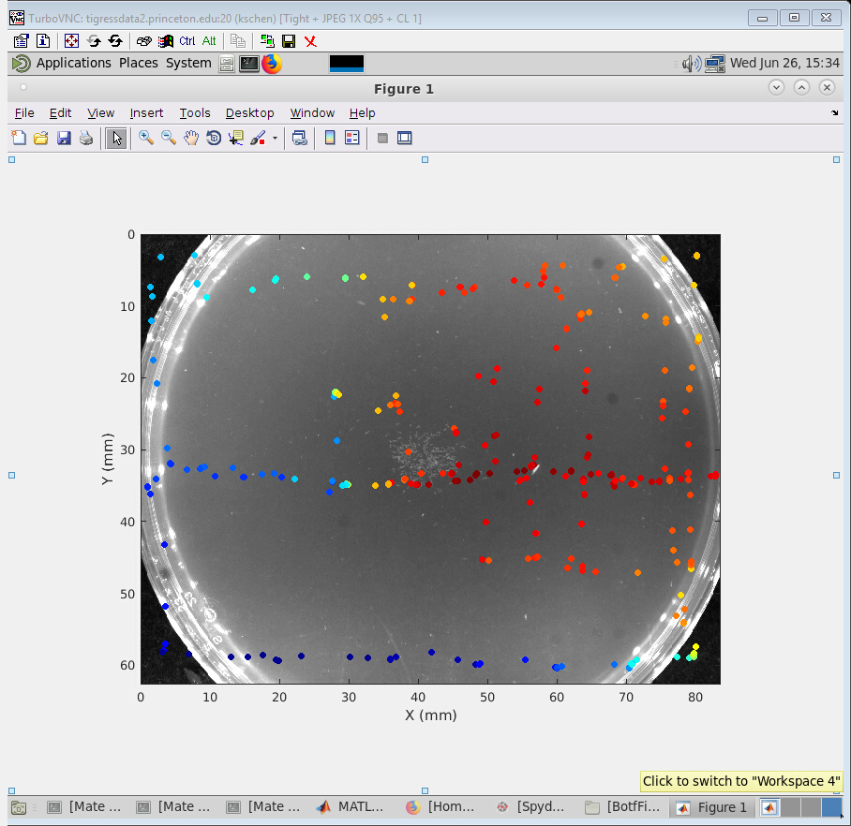
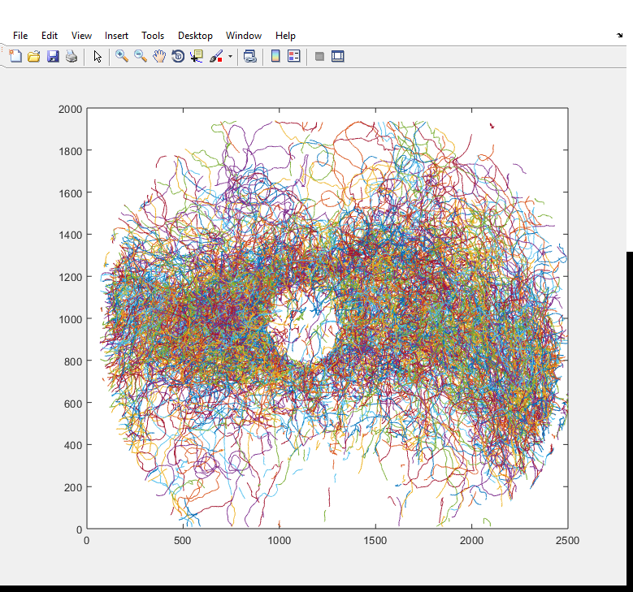

Slide 2
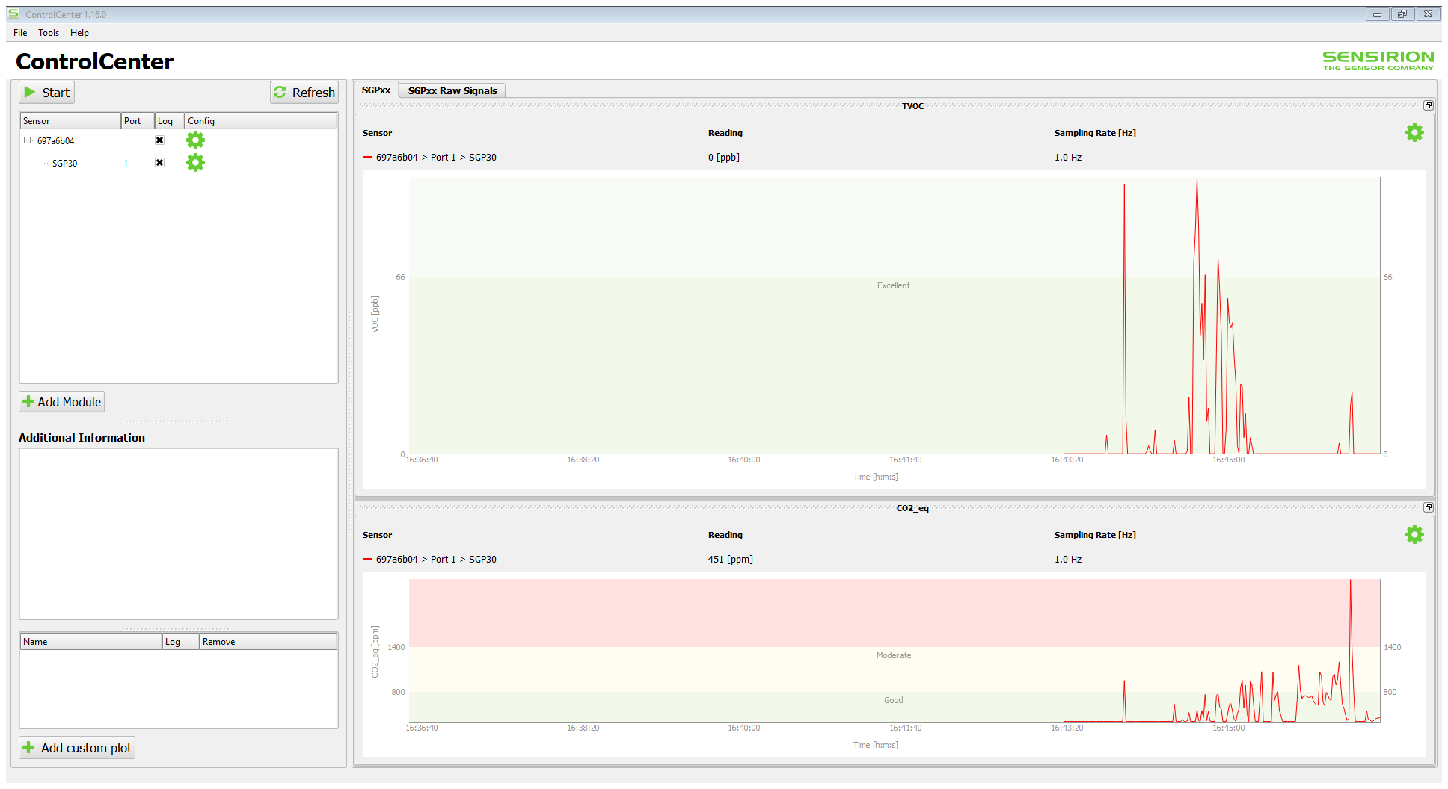

Slide 3
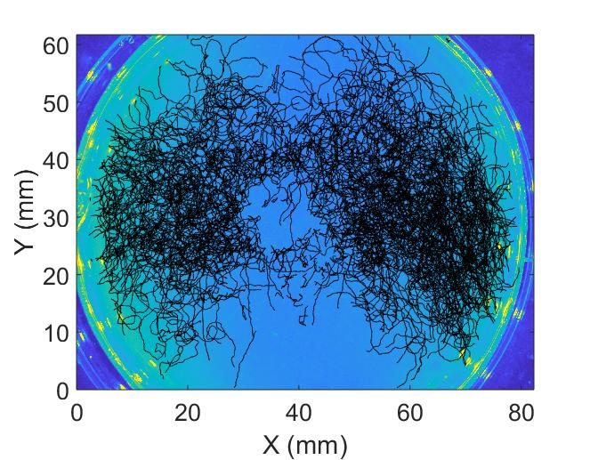

Slide 4
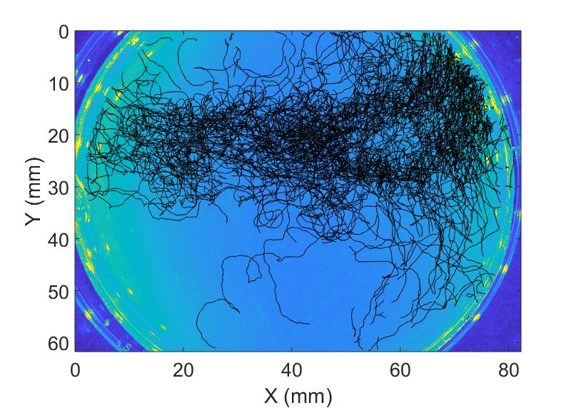

Slide 5
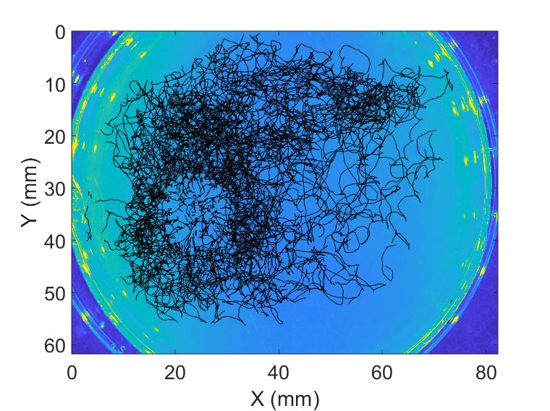

Slide 6
Top view (x-y)
180 mm
140 mm
6.35 mm
(1/4 inch)
(0.04 inch wall)
30 mm
30 mm
90 mm
130 mm
90 mm
30 mm
20 mm
20 mm
X
Y

Slide 7
Side view (y-z)
acrylic cover
6 mm
6.35 mm
(1/4 inch)
(0.04 inch wall)
30 mm
17.65 mm
14 mm
agar
8 mm
Table
30 mm
90 mm
Z
Y

Slide 8
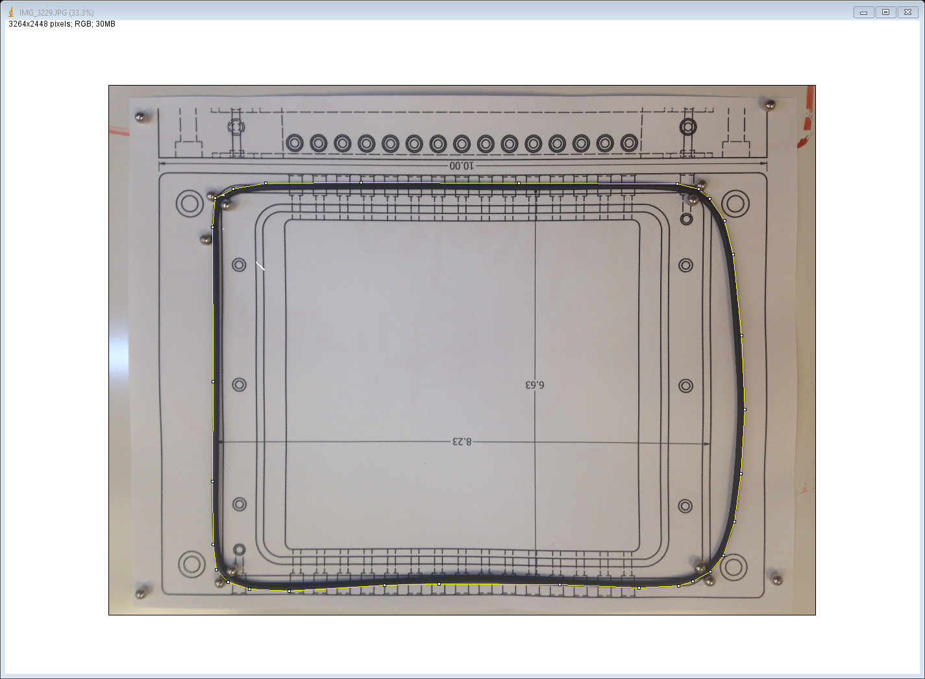
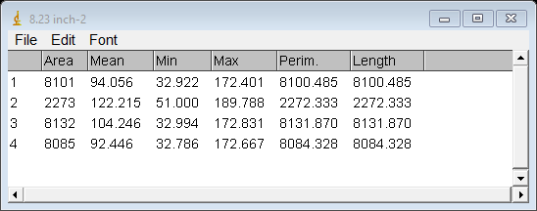

Slide 9
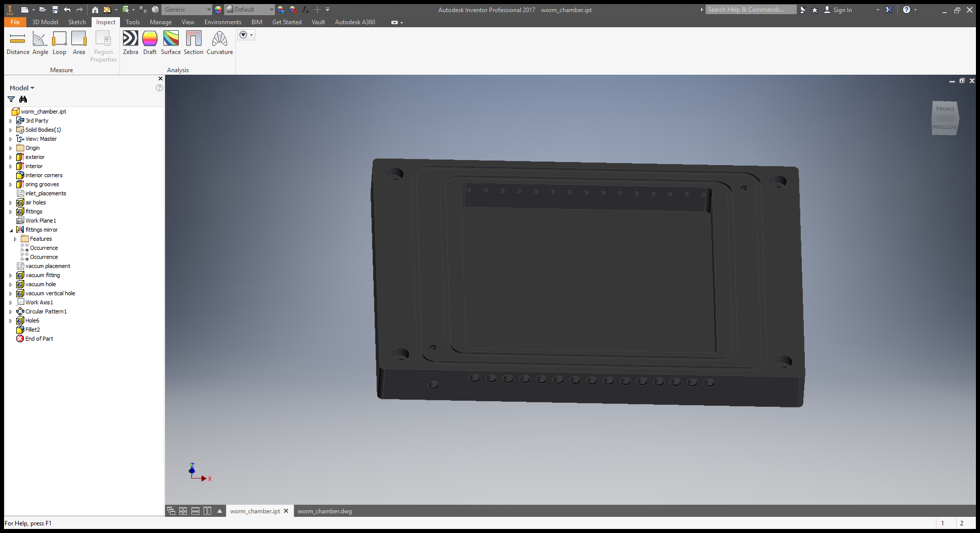
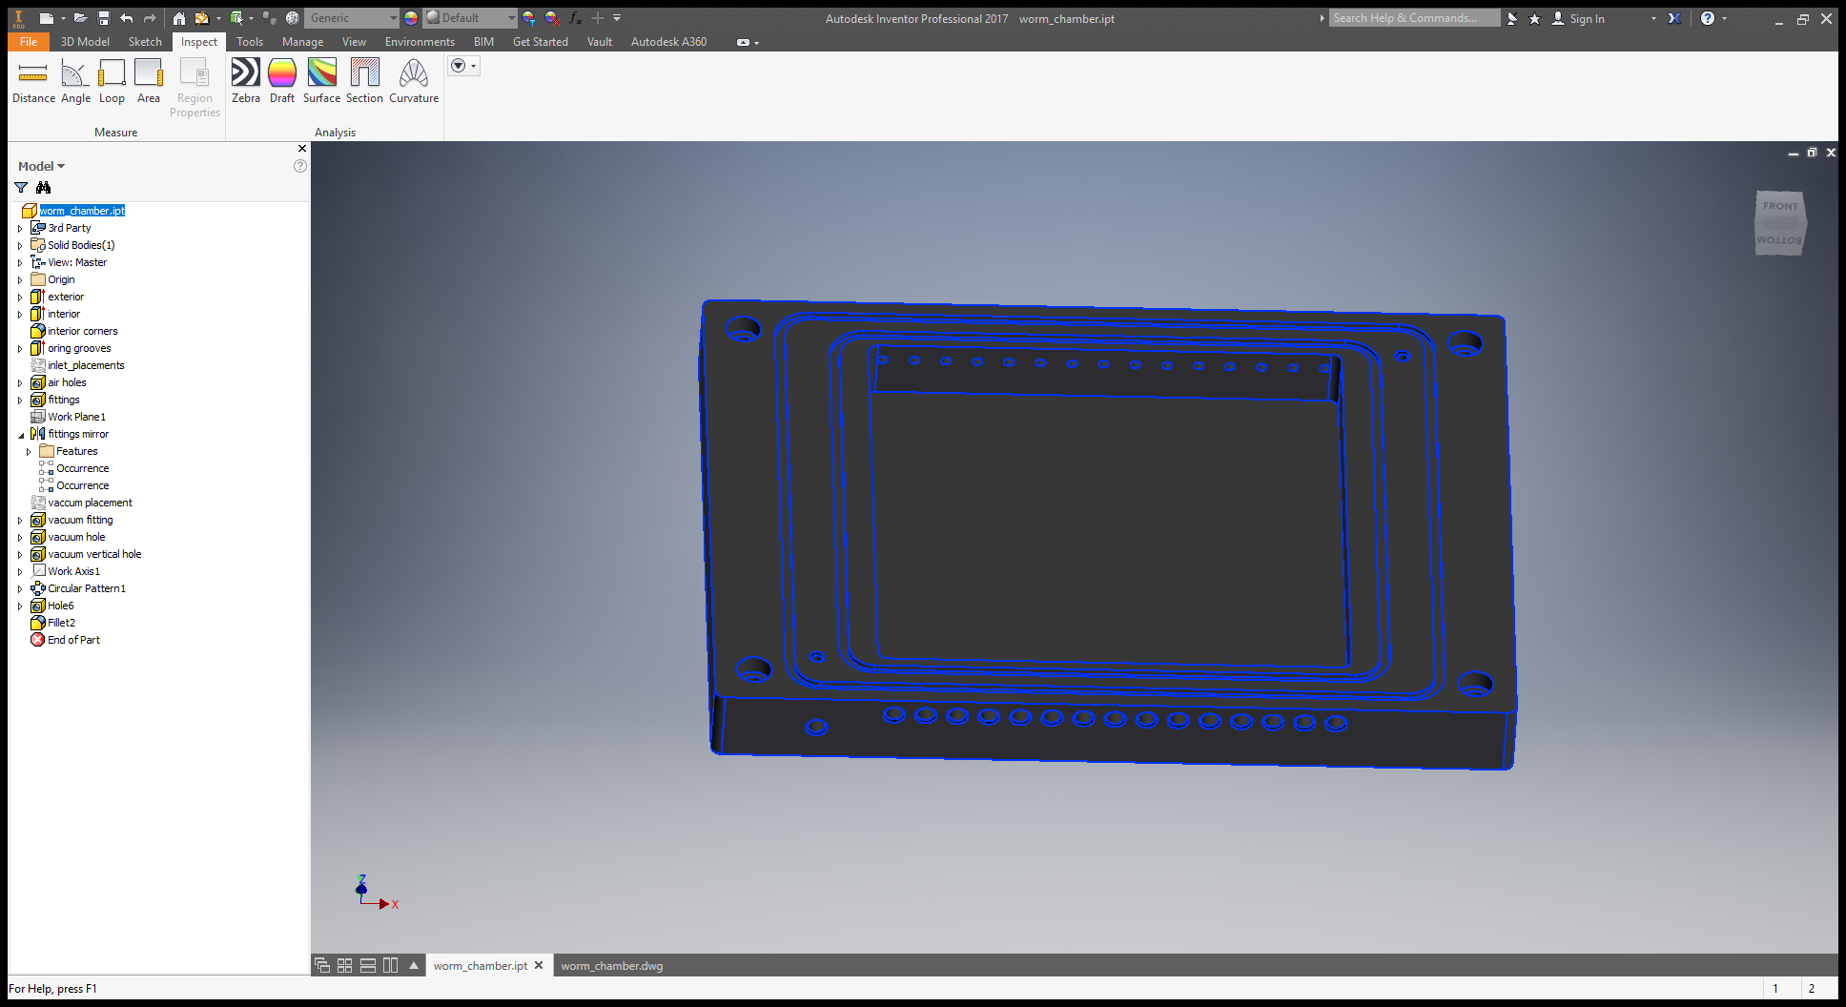

Slide 10
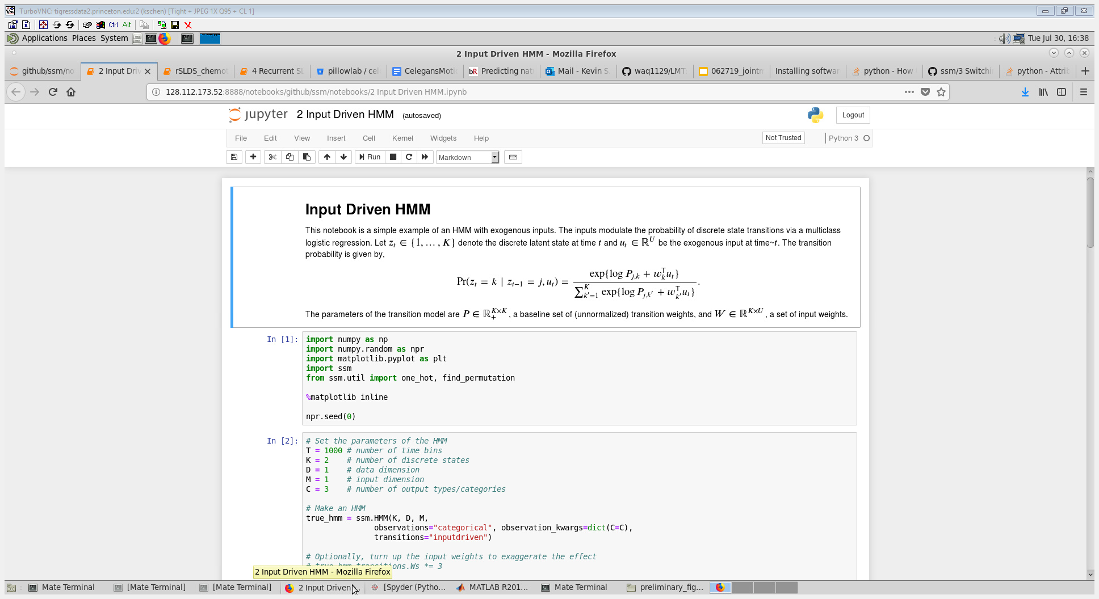

Slide 11
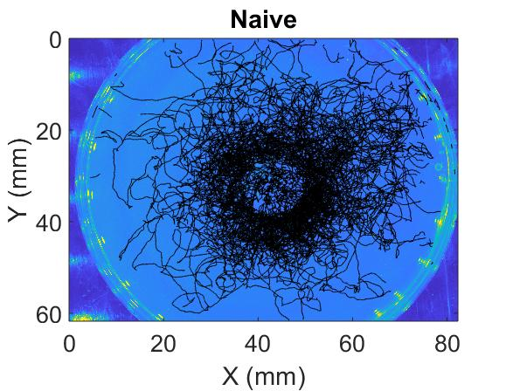
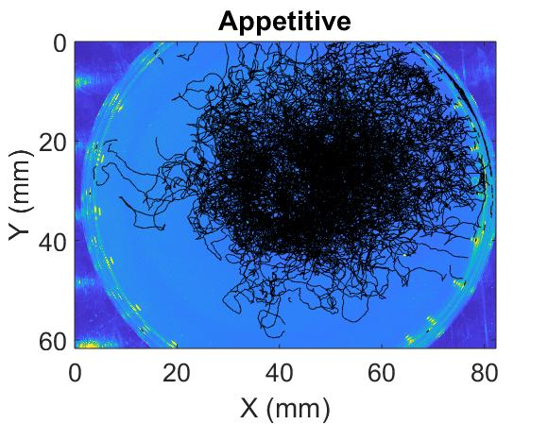

Slide 12

(odor->calcium->...->behavior->trajectories)
Neuron biophysics (Kato et al.)
(Imaging (aim 3))
Mode to motion (Stephens et al.)
Odor
Sensory
(Network)
Behavior
Movement
Map sensory-motor transformation with optogenetics (aim 2)
Monitor olfactory cues and motion trajectory during chemotaxis (aim 1)

Slide 13
Static vs. adaptive sensory-motor transformation
GLM
[odor]
{dθ, dv}
(a)
[odor]
(b)
[odor]t-1
[odor]t
[odor]t+1
(c)
[odor]t-1
[odor]t
[odor]t+1
(d)
statet
GLM
mGLM
mGLM
mGLM
mGLMt-1
mGLMt
mGLMt+1
π(a|s)
P(s’|s,a)
{dθ, dv}
{dθ, dv}t-1
{dθ, dv}t
{dθ, dv}t+1
{dθ, dv}t-1
{dθ, dv}t
{dθ, dv}t+1
actiont
iRL: Find value v*(s) and policy
π*(a|s) corresponding to {S,A}

Slide 14
(a)
(b)
(c)
(d)
St-1
St
St+1
St
St
St
Zt-1
Zt
Zt+1
St
Zt
Xt
π(a|s)
P(s’|s,a)
at
Xt-1
Xt
Xt+1
at
Xt
at
at-1
at
at+1
θt

Slide 15
St
S: Sensory input
(odor concentration)
St-1
St
St+1
Zt-1
Zt
Zt+1
Zt
Z: Discrete behavioral state
(latent behavioral states)
(a)
St
Xt-1
Xt
Xt+1
Xt
St-1
St+1
X: continuous posture
(gradual head angle change)
Xt-1
Xt
Xt+1
a: actions for navigation
(movement in space)
at-1
at
at+1
θt
at-1
at
at+1

Slide 16
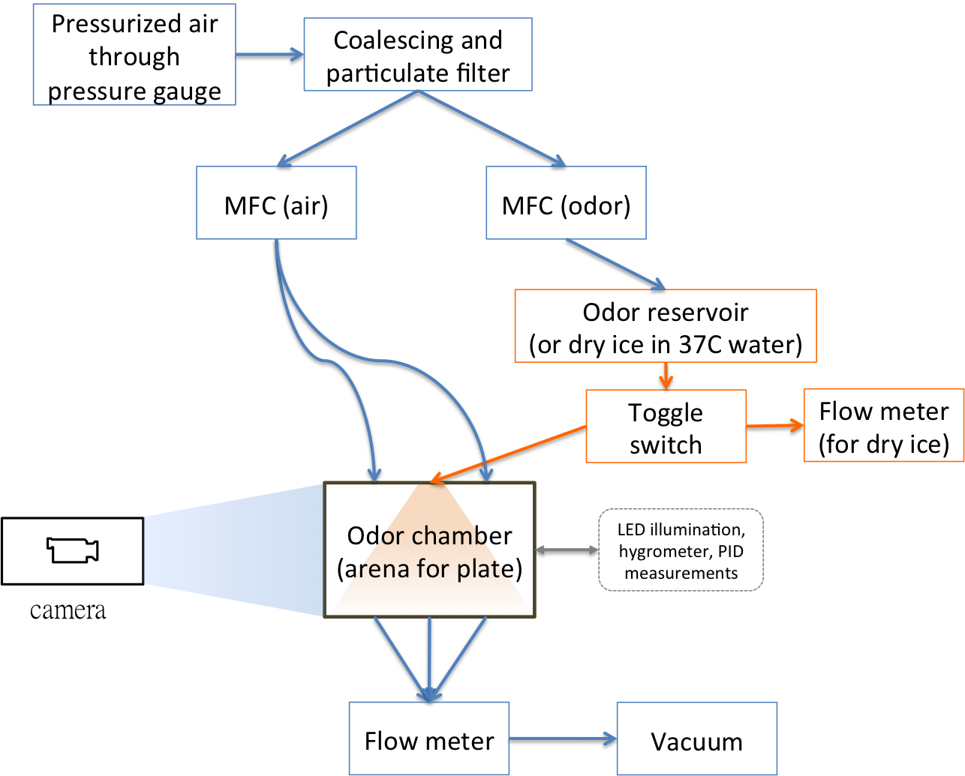
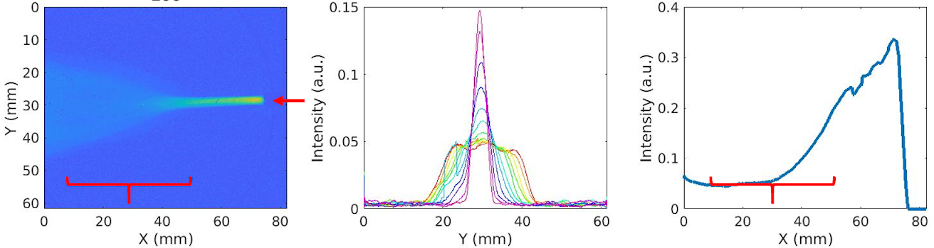
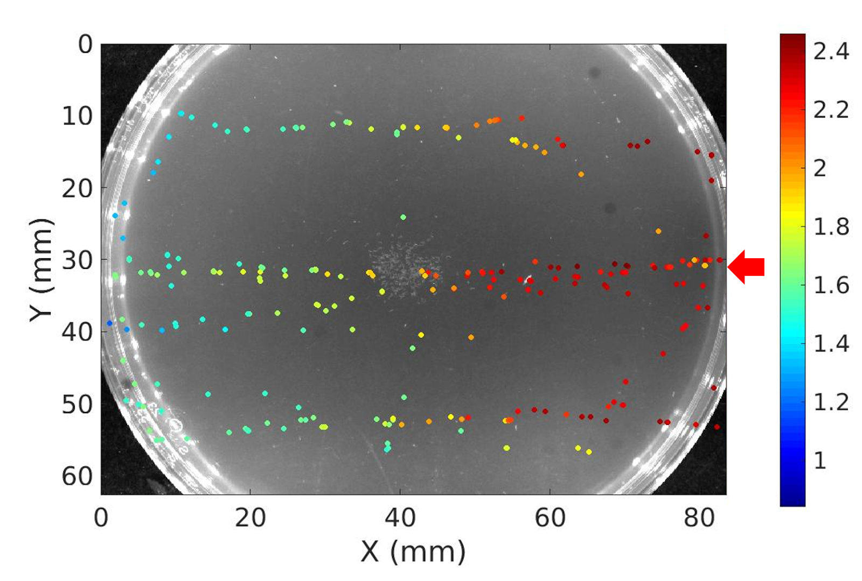
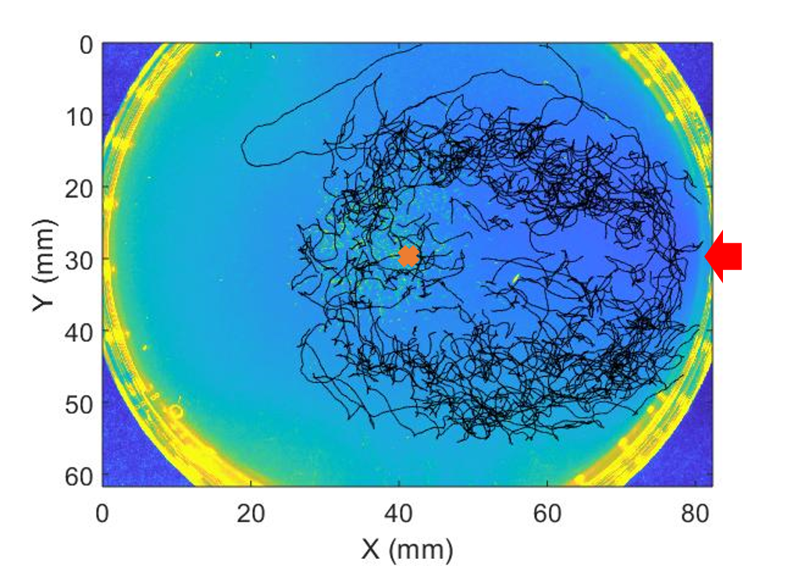
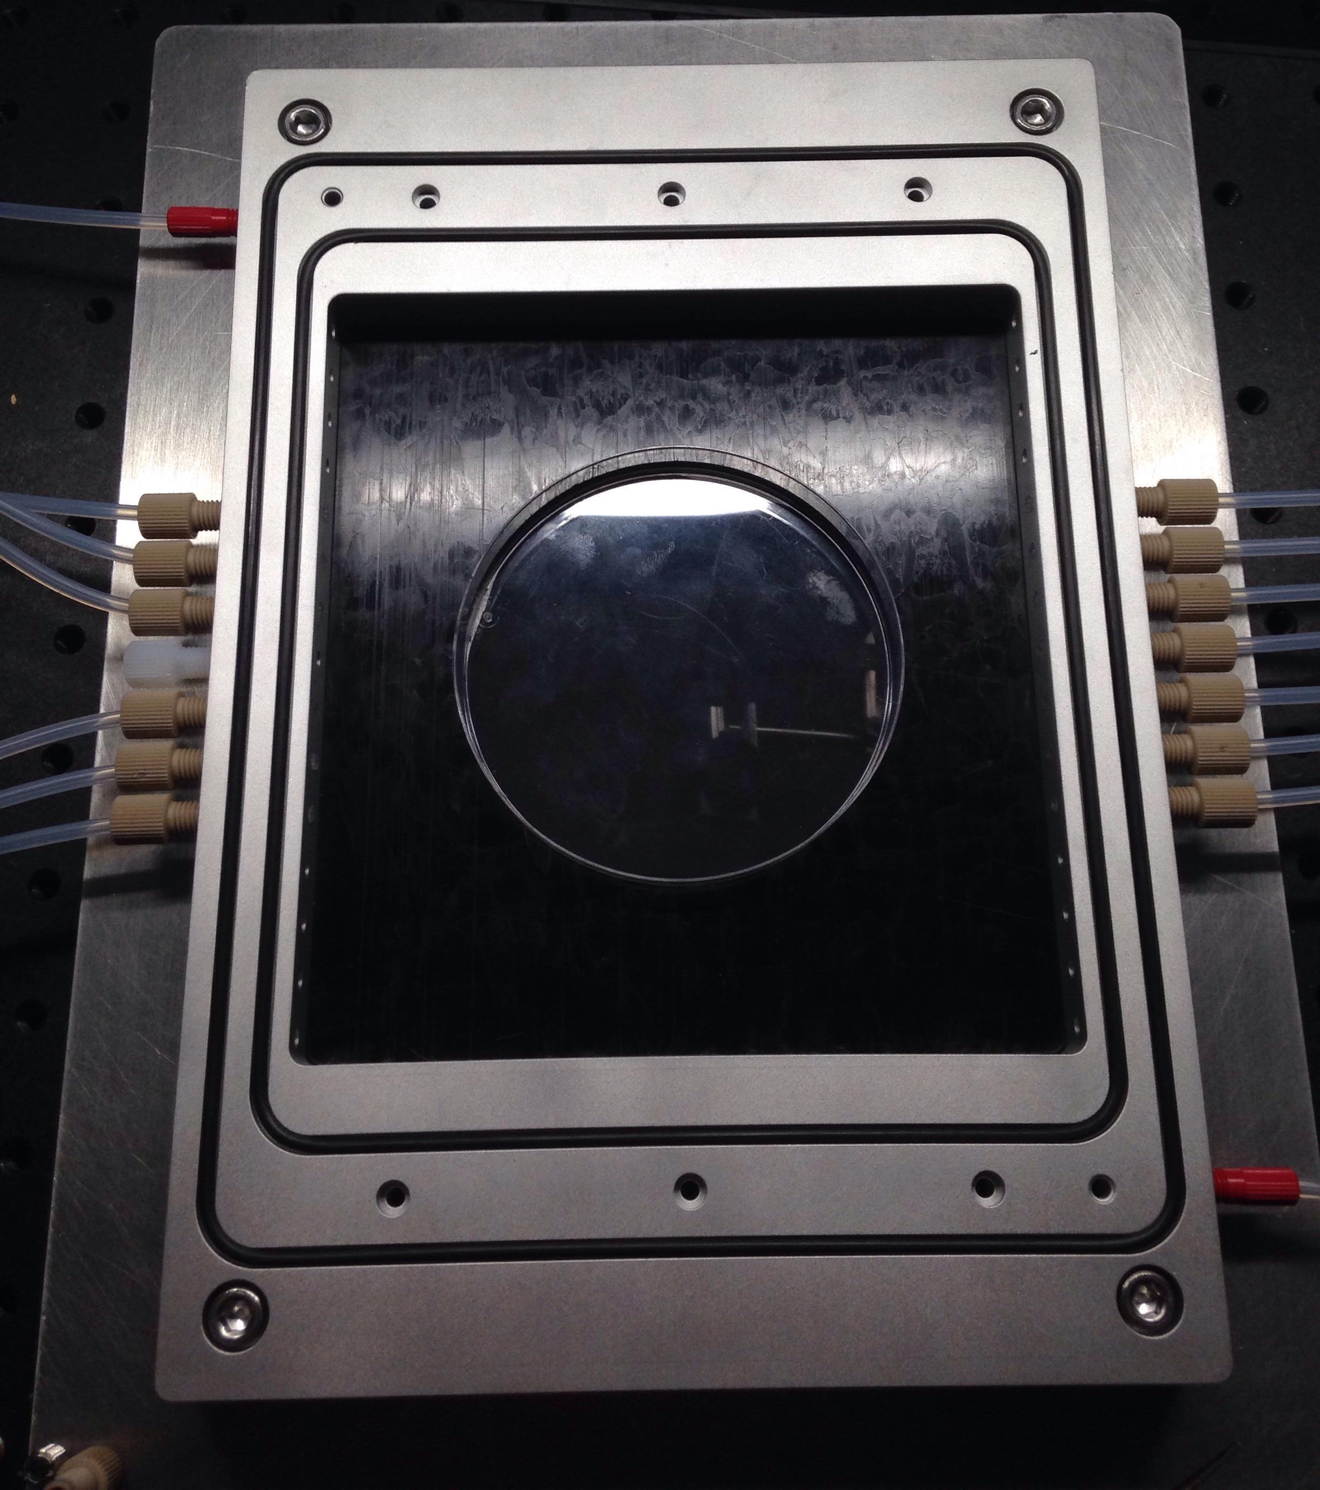
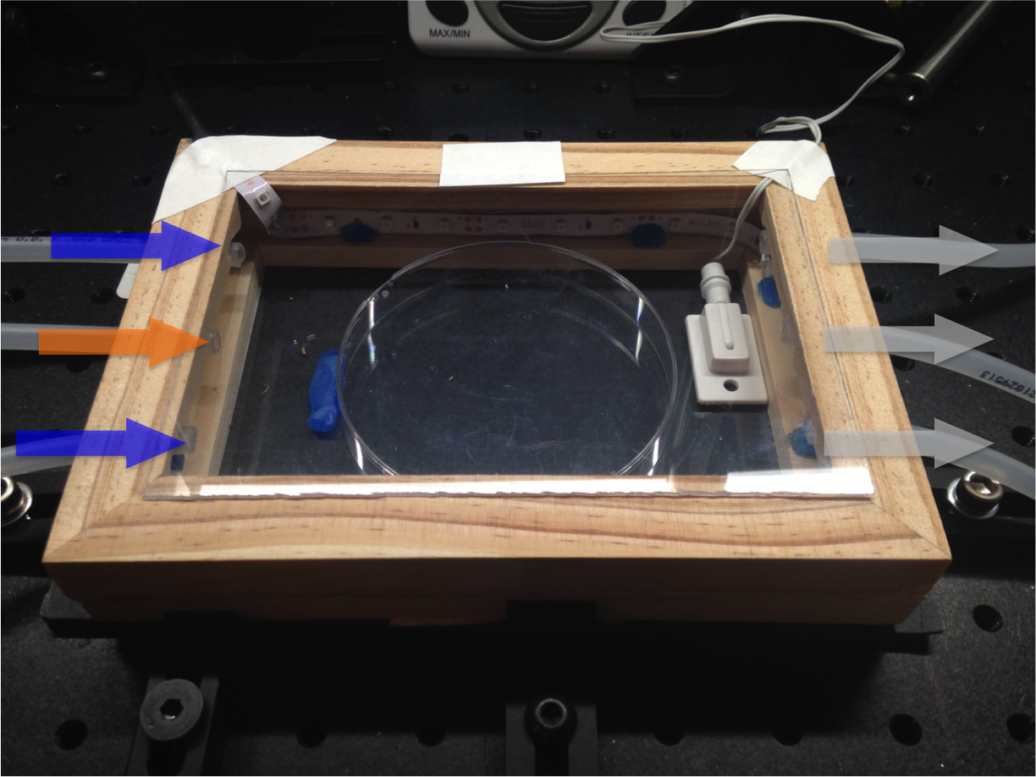
(a)
(b)
(c)
(d)

Slide 17
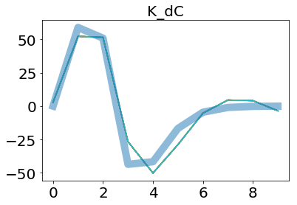
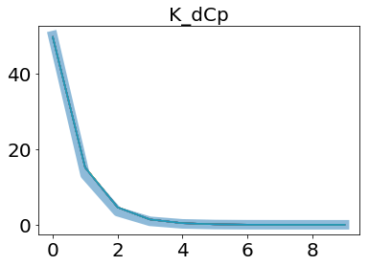
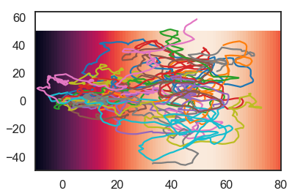
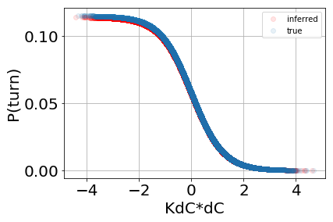
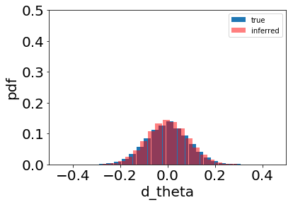
(b)
(c)
(a)
(d)
(e)

Slide 18
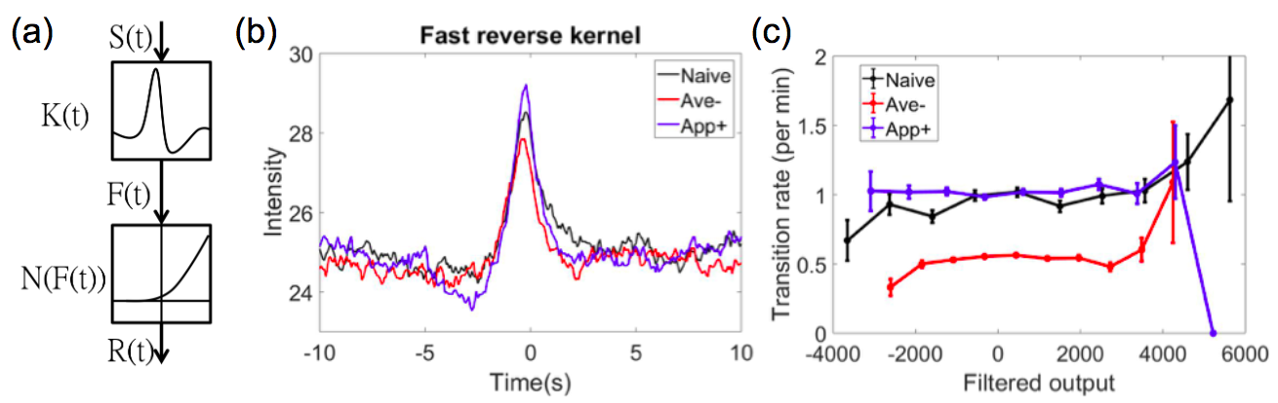

Slide 19
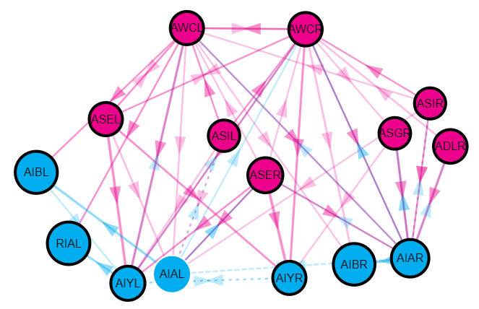
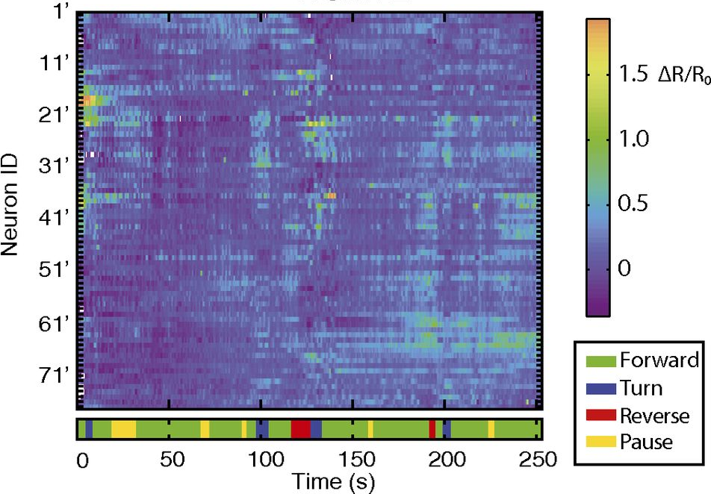
(a)
(b)
(c)
Representation | Appetitive learning | Aversive learning | Long exposure
Odor signal | Unchanged | Unchanged | Adapted
Learning experience | Increased | Decreased | Unchanged

Slide 20
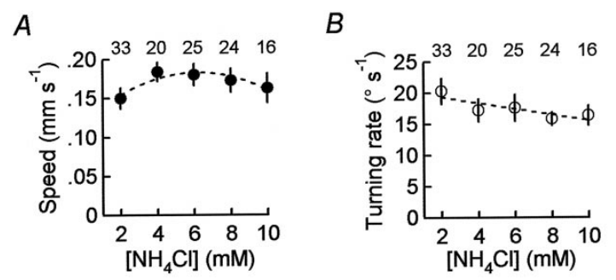

Slide 21
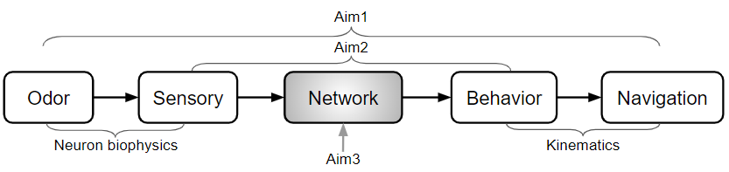
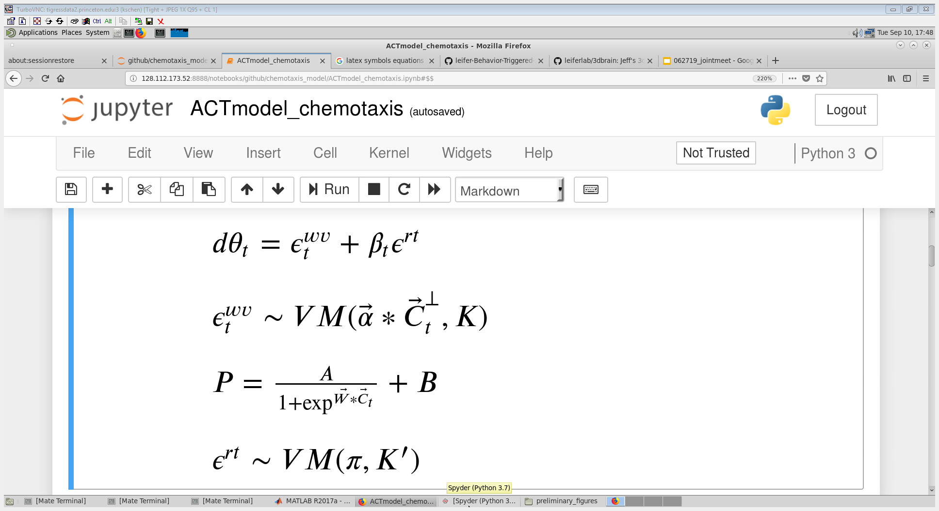

Slide 22
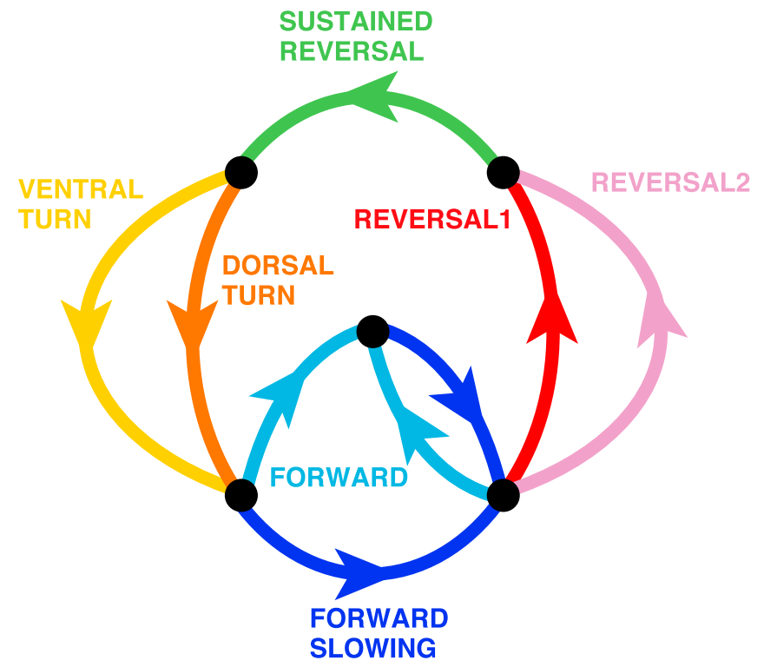
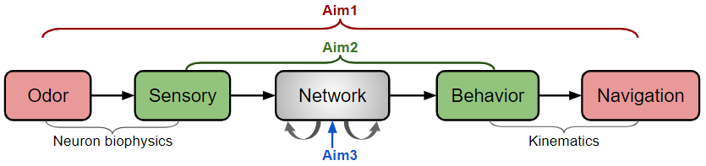


Slide 23
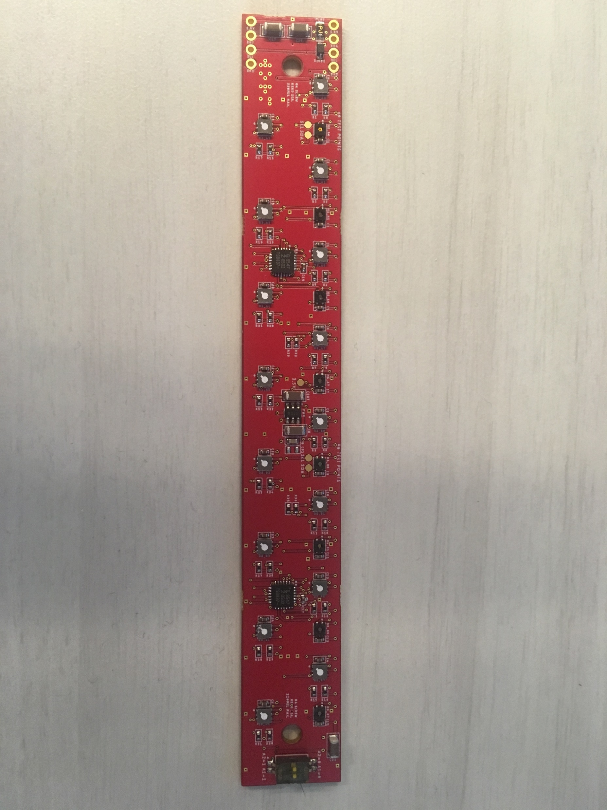
Cables
Uniform flow from inlets
Open outlets
Front
Back

